Slide 1
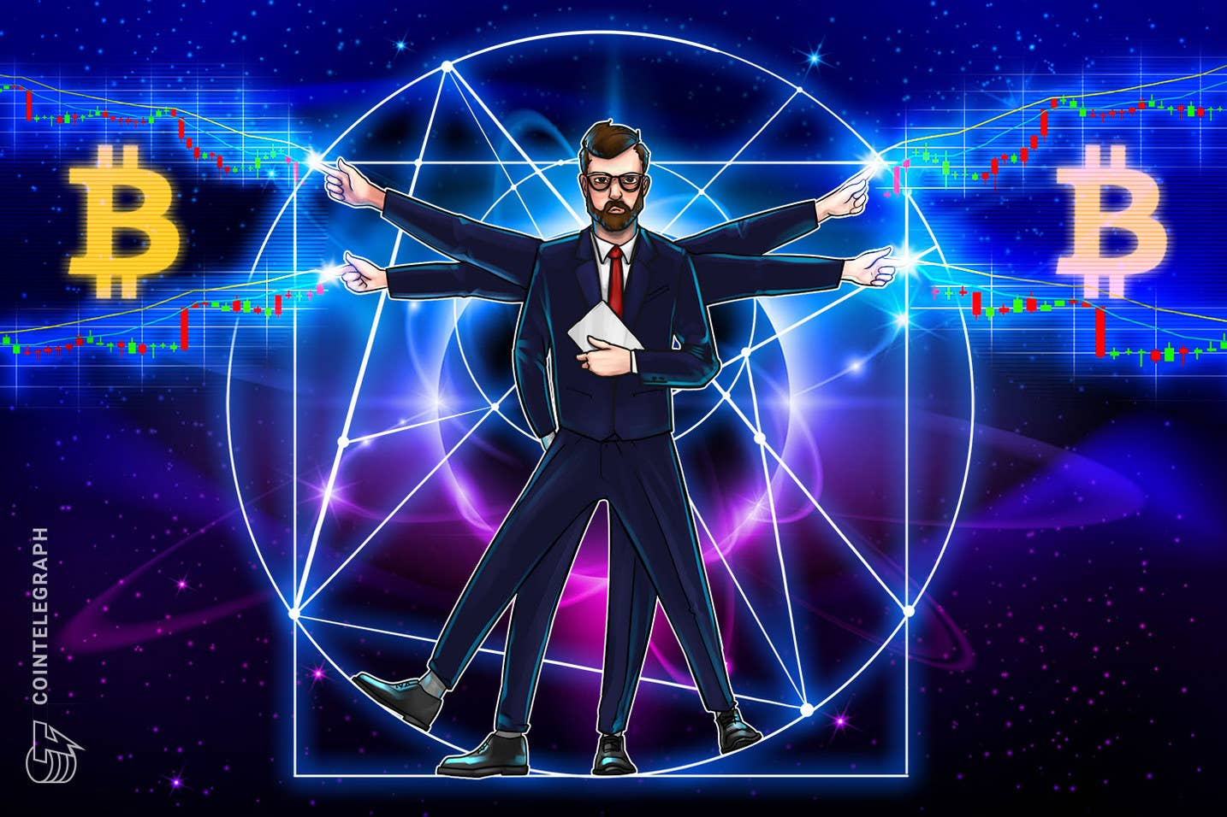

HOW TO LOSE MONEY PROFESSIONALLY
By: YOURS TRULY

Slide 2

GOAL: ACHIEVE ULTIMATE GLORY!
ULTIMATE GLORY:
“CATASTROPHIC LOSS OF THE PORTFOLIO”
- SAID NOBODY

Slide 3
HISTORY OF PAIR TRADES
Developed by a group at Morgan Stanley in the 80s.
Consisted of a team of physicists, engineers, and mathematicians
HOWEVER! The models were secret!
Pros: Market-Nuetral, High Hit Ratio, Relatively Simple
Cons: At the end of presentation.

Slide 4
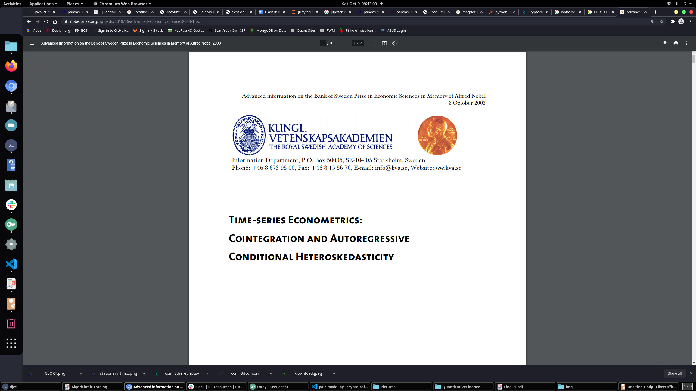
2003 NOBEL PRIZE IN ECON

Slide 5
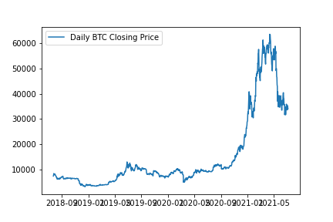
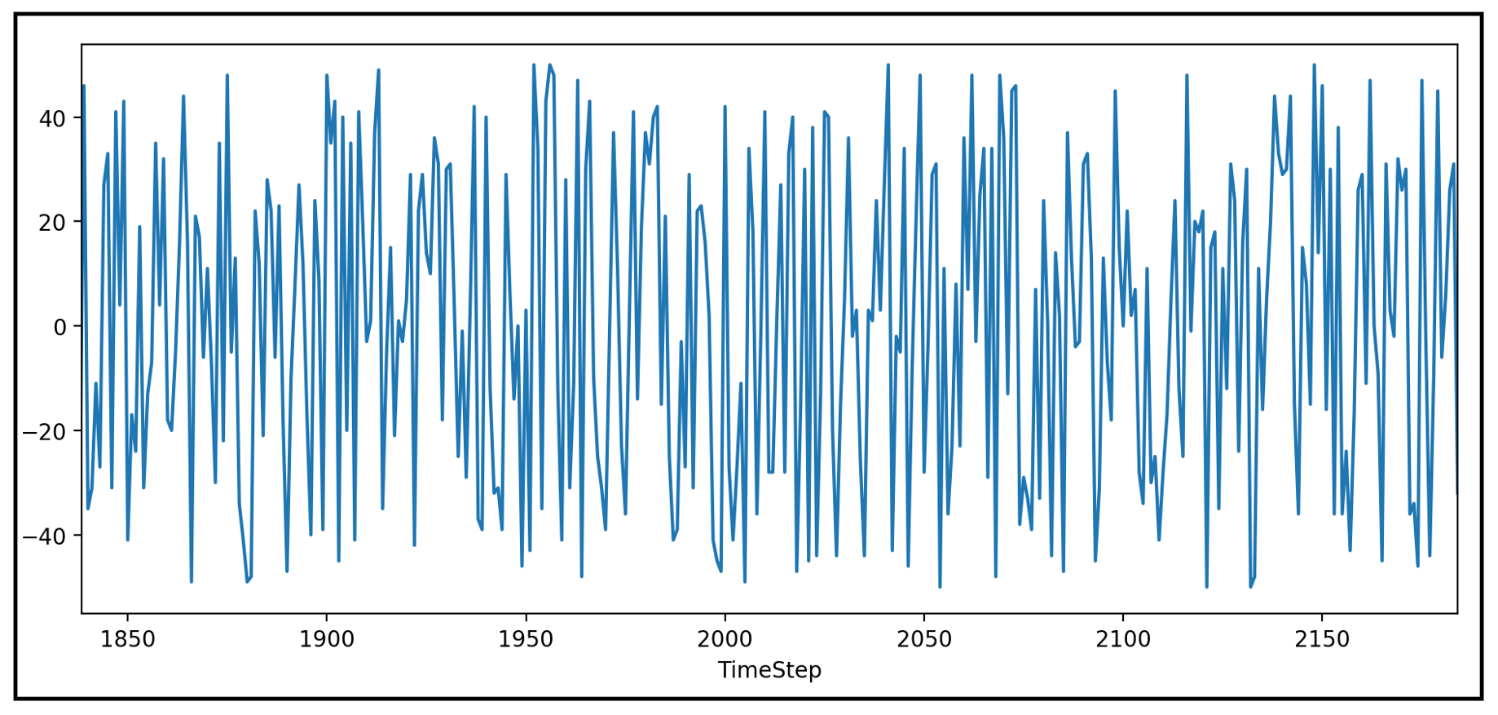
STATIONARY AND NON-STATIONARY TIME-SERIES

Slide 6
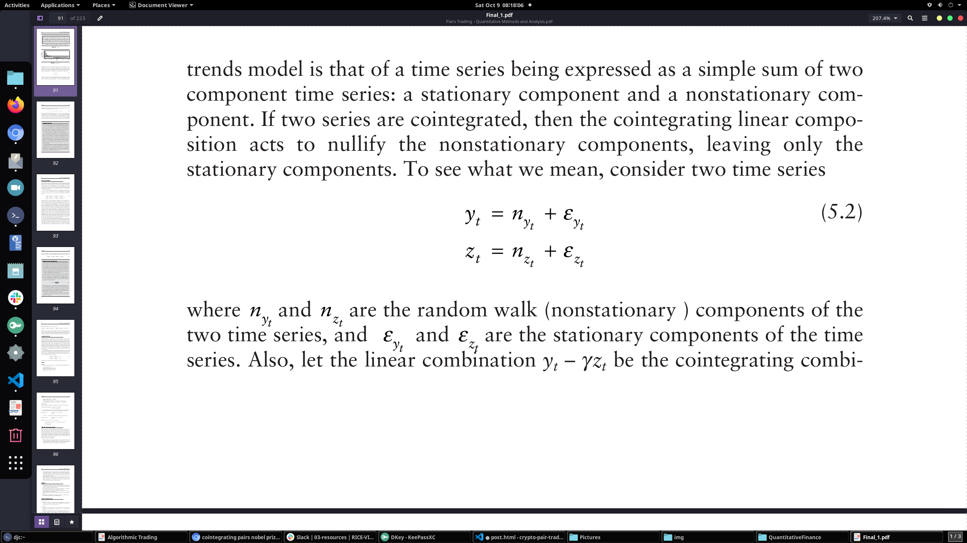
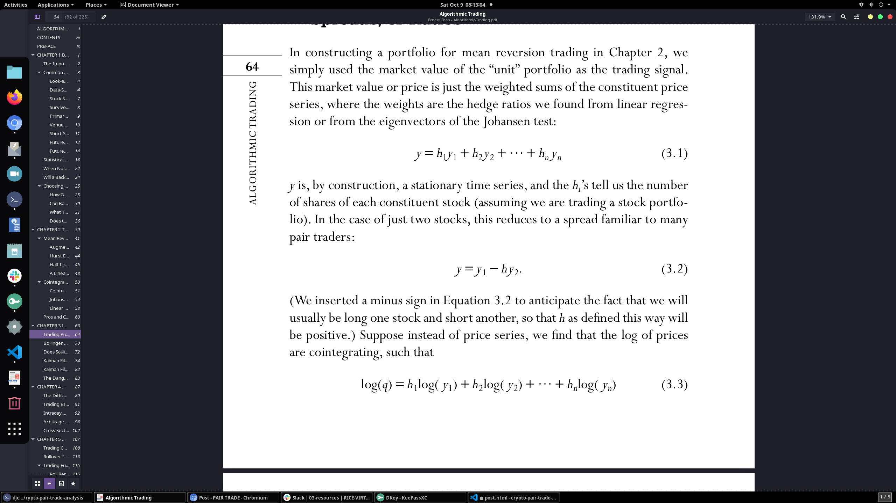
LITTLE BIT OF MATH

Slide 7
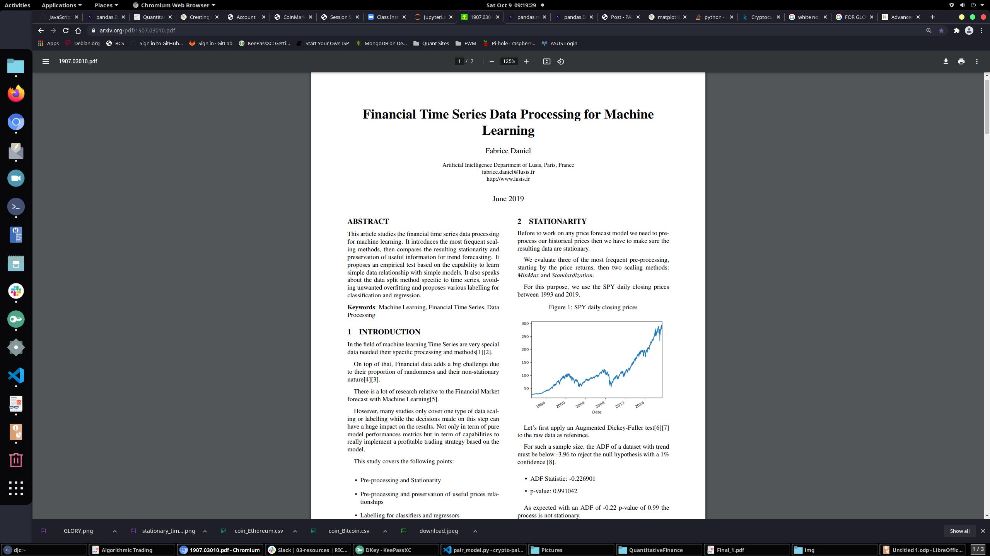
PREPROCESSING

Slide 8
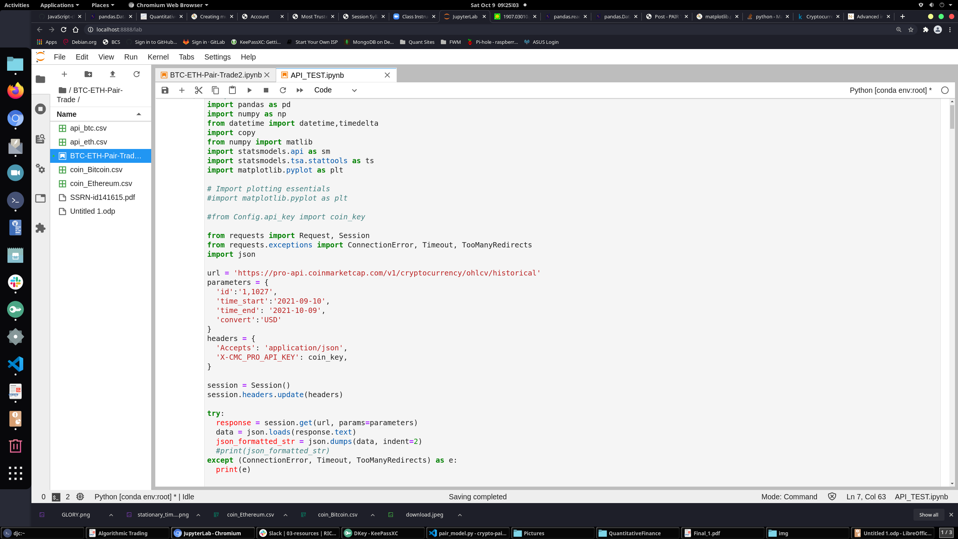
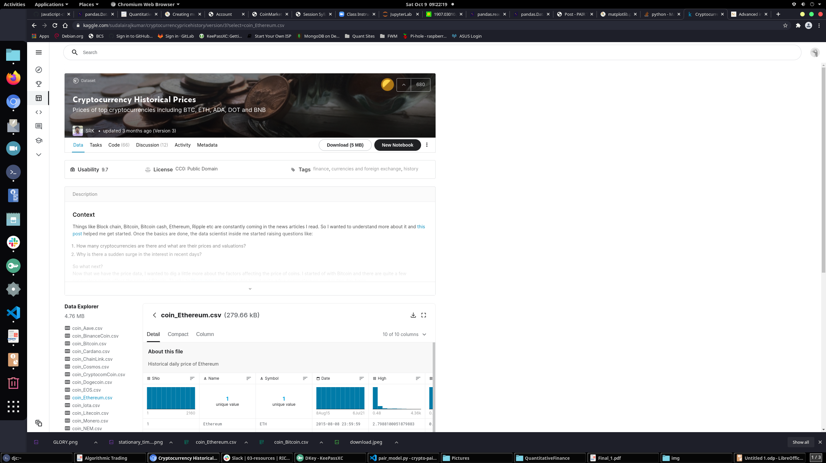
DATA ETL

Slide 9
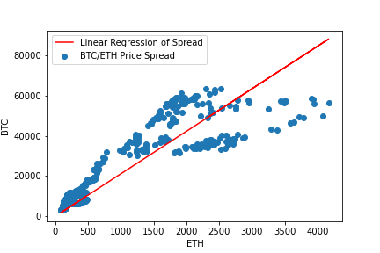
METHODOLOGY
First things first:
We have to find the hedge ratio such that BTC-beta*ETH is stationary (or near stationary)
So we need OLS model.
Problem: How do we determine the look-back window?

Slide 10
Some more Maths
dy(t) = ( λ y(t − 1) + μ )dt + d ε
Quantitative approach for determining look-back window.
Very comforting compared to ML IMO.

Slide 11
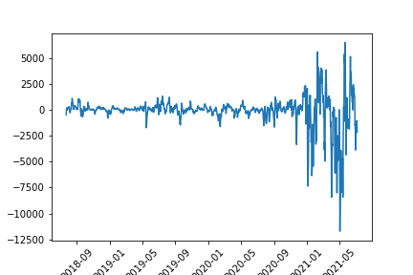
The Unit Portfolio

Slide 12
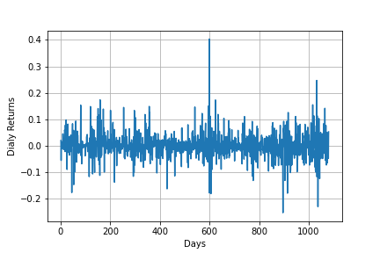
PnL

Slide 13
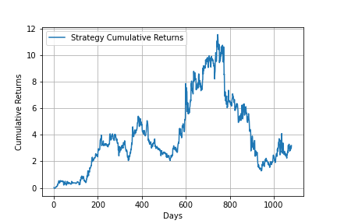
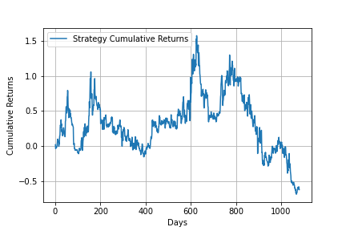
How did we do?

Slide 14
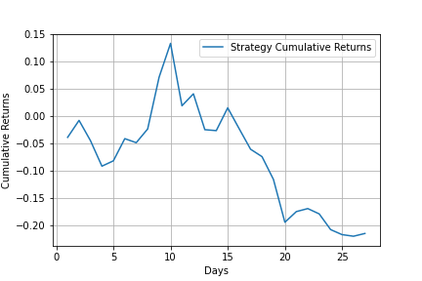
WE ACHIEVED ULTIMATE GLORY!

Slide 15
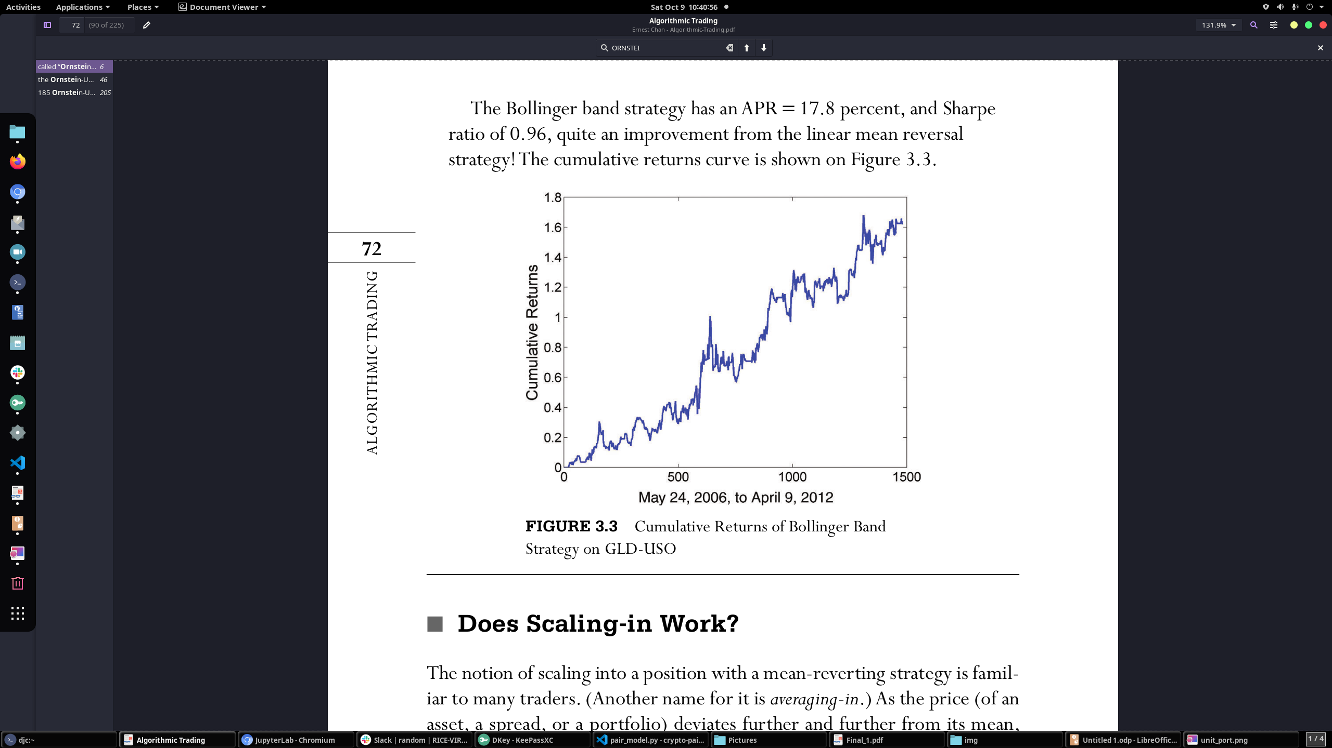
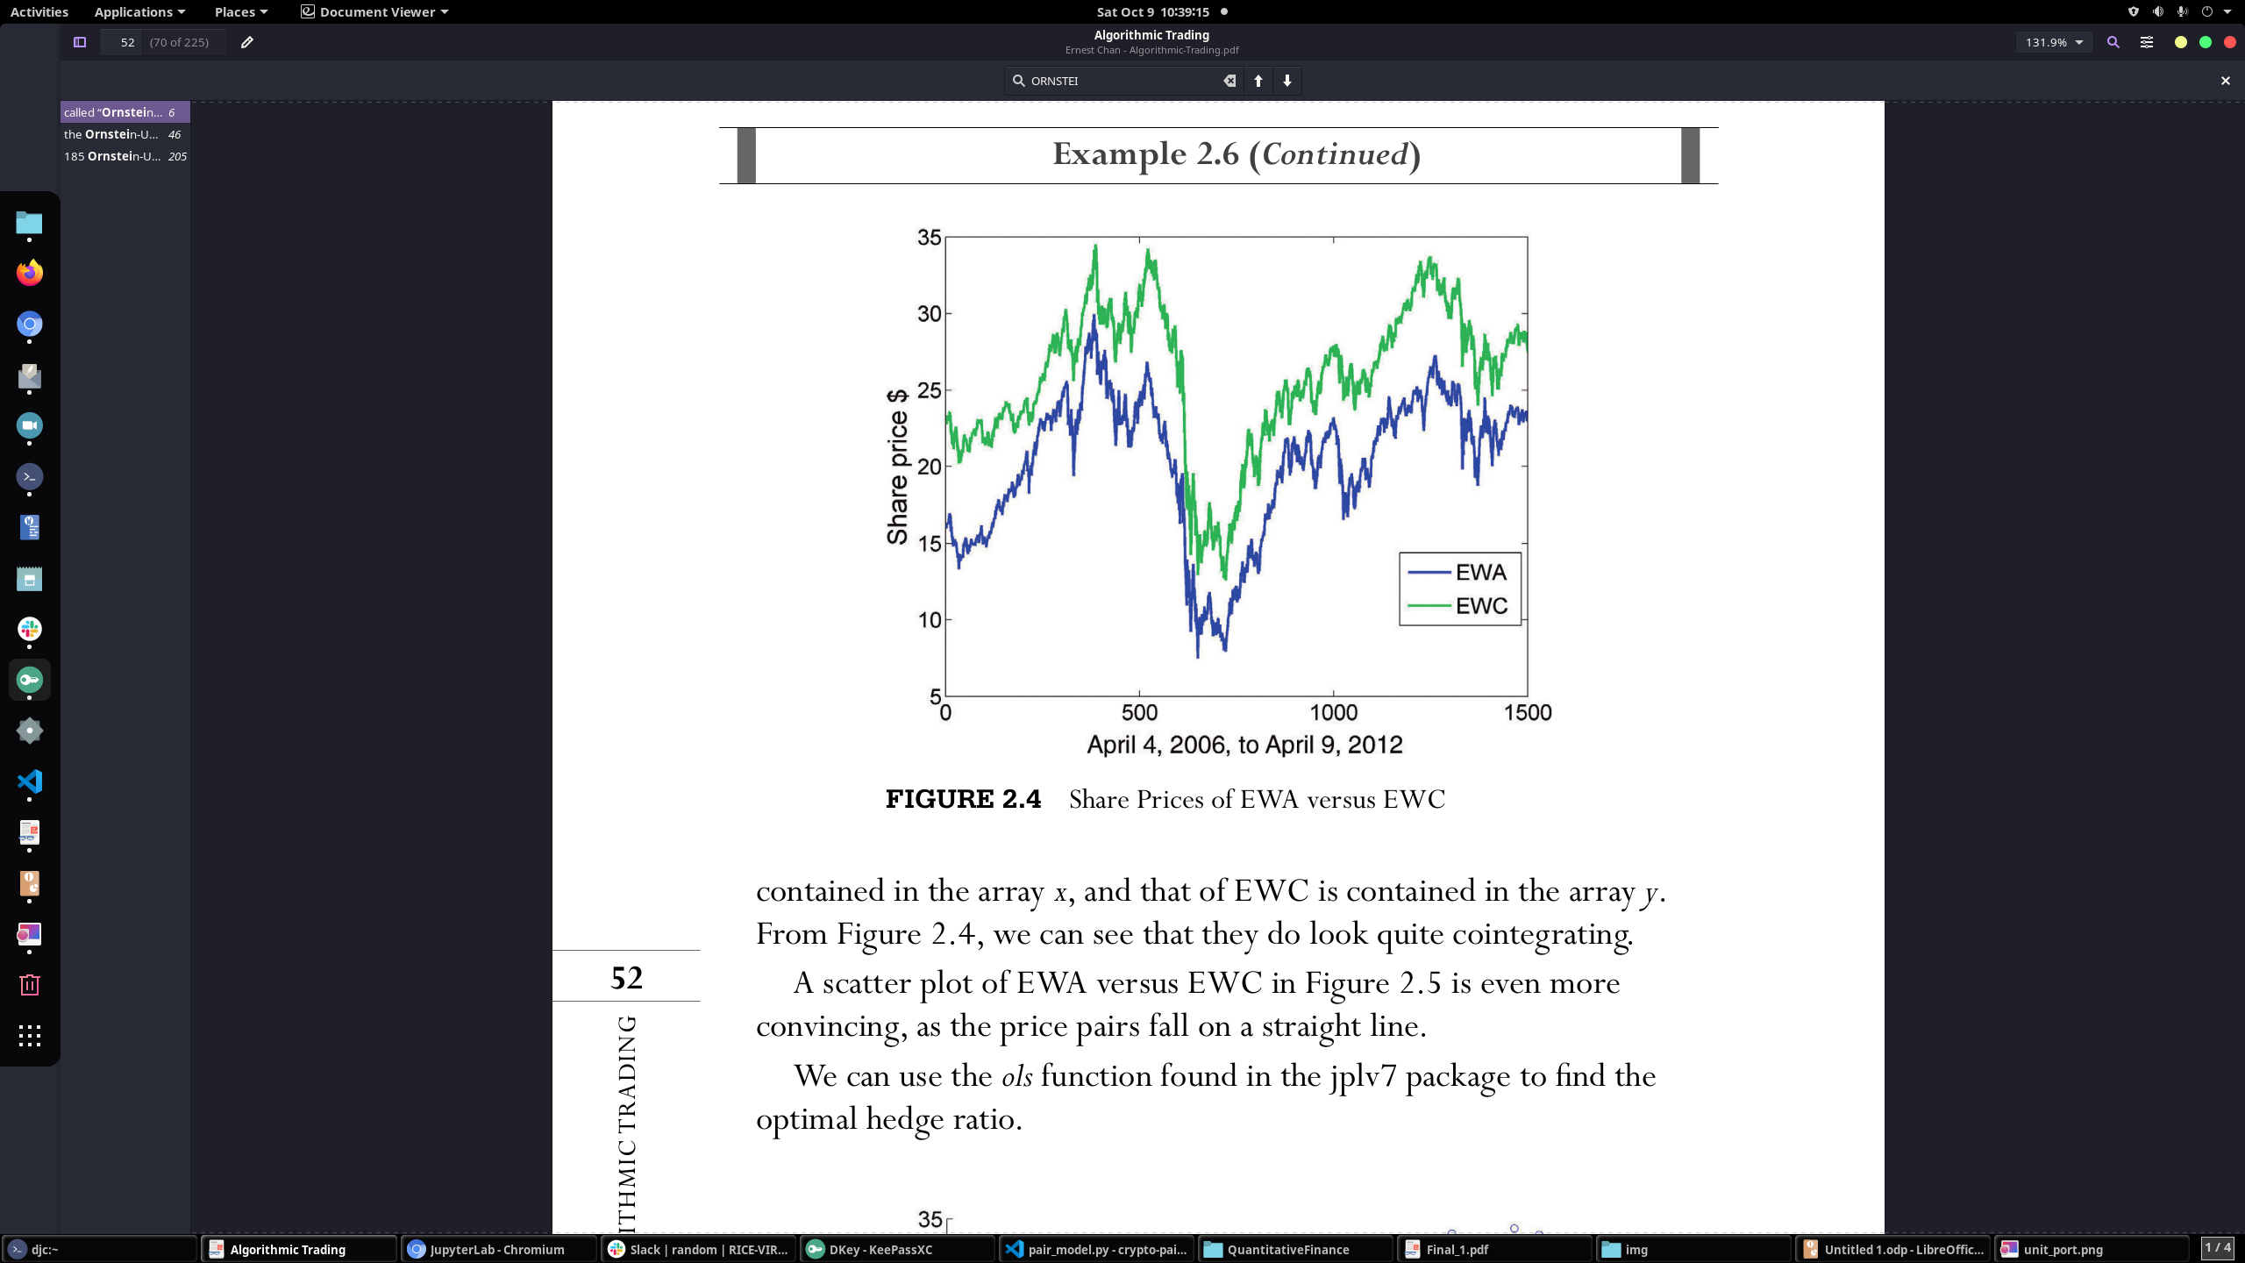
Example of a good Model

Slide 16
TIME FOR THE BLOG (WORK IN PROGRESS)
DISCLAIMERS:
WE DID NOT INCLUDE TRANSACTION COSTS!
WE DID NOT RIGOROUSLY TEST FOR BIAS
WE ARBITRARILY CHOOSE THE LOOK-BACK WINDOW
(WHICH INTRODUCES MORE BIAS)
NO RISK MANAGEMENT SYSTEM IN PLACE! (NO REGRET MODELS)
DID NOT ACCOUNT FOR SHORT SQUEEZE RISKS
WE ARE NOT DIVERSIFIED ACROSS SECTORS OR STRATEGY
POTENTIAL OPPORTUNITY TO APPLY KALMAN FILTER!
PYTHON IS NOT RECOMMENDED FOR THIS AS WELL!

